Slide 1
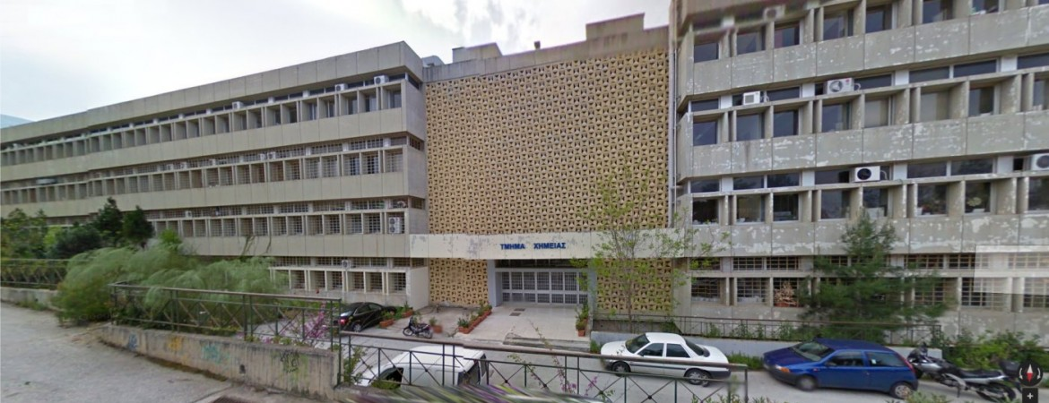
Department of Chemistry @ NKUA
Partial view of Chemistry facilities
on the main university campus east of downtown Athens

Slide 2
Chemistry @ NKUA in numbers
150 undergraduate students × 4 years (no tuition)
236 graduate students trained for 1.5-2 years (mostly with tuition)
168 PhD candidates (some on scholarships)
11 postdocs
44 active faculty members (assistant, associate, full professors)
34% with PhDs from USA, UK, France, Germany, Belgium
Almost all with international postdoctoral experience

Slide 3
The Chemistry Department has
8 Laboratories
PHYSICAL CHEMISTRY
INORGANIC CHEMISTRY
ORGANIC CHEMISTRY
INDUSTRIAL CHEMISTRY
ANALYTICAL CHEMISTRY
FOOD CHEMISTRY
ENVIRONMENTAL CHEMISTRY
BIOCHEMISTRY

Slide 4
RESEARCH ACTIVITIES IN THE CHEMISTRY DEPARTMENT
CHEMISTRY AND HEALTH
NOVEL SYNTHETIC COMPOUNDS WITH NEW TARGETS
GREEN AND VIABLE PHOTOCATALYSIS-CATALYSIS –ENERGY
CHEMISTRY AND HEALTH NEW THERAPEUTIC TARGETS
WITH THE USE OF NOVEL METHODOLOGIES
THEORETICAL AND COMPUTATIONAL STUDIES.
BEHAVIOUR OF MOLECULAR SYSTEMS OF MATERIAL
ENVIRONMENTAL POLLUTION ENVIRONMENTAL ADMINISTRATION
NEW MATERIALS NANOTECHNOLOGY – PROBES
STUDY OF NEW REACTIONS AND PRODUCTION OF NEW COMPOUNDS
POLYMERS AND THEIR APPLICATIONS
CHEMICAL ANALYSIS
QUALITY CONTROL
FOOD- CONTROL AND SECURITY
NOVEL DIET PRODUCTS

Slide 5


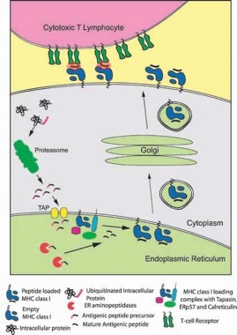
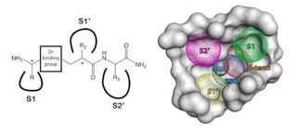

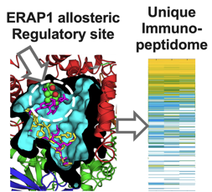
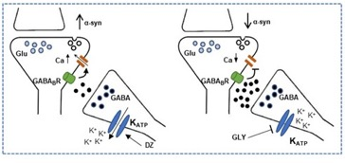
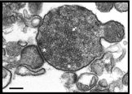

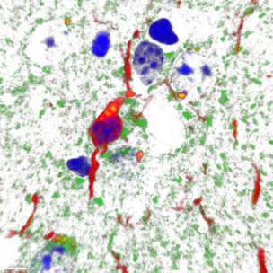
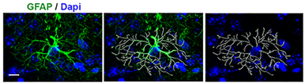
Laboratory of Biochemistry
https://biochemistry.chem.uoa.gr/
Dr. E. Stratikos (Assoc. Prof. – Director)
Biochemistry of the Immune System
Antigen Presentation / Adaptive Immunity
Protein Structure and Function - Enzymology
Molecular Immunology
Structural Biology (X-ray Crystallography)
Biophysics – Chemical Biology
Drug development – Medicinal Chemistry
(Cancer Immunotherapy and autoimmunity)
Synaptosomes
Dr. E. Emmanouilidou (Assist. Prof.)
Biochemistry of the Nervous System
Molecular mechanisms of protein secretion and degradation
Cellular Biology – Cell networks
Animal models of human disease
Confocal Microscopy – Fluorescence Microscopy
Molecular mechanisms of disease (Neurodegenerative diseases, Parkinson’s Disease, synucleinopathies)

Slide 6

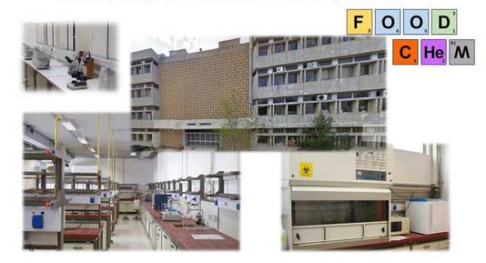
Food Chemistry Laboratory
Faculty Members
Proestos Charalampos (Associate Professor, Director)
Valdramidis Vasiilis (Associate Professor)
Dasenaki Marilena (Assistant Professor)
Official Site: https://foodscience-en.chem.uoa.gr/el/
RESEARCH FIELDS
Food Chemistry and Analysis
Foodomics
Food contaminants determination
Food microbiology (Euro Food safety 2 lab) and technology
RnD for functional foods
New product development (https://alchemy.eadppa.gr/en/white-wine/ )
HORIZON MSCA 2021 SE 01

Slide 7


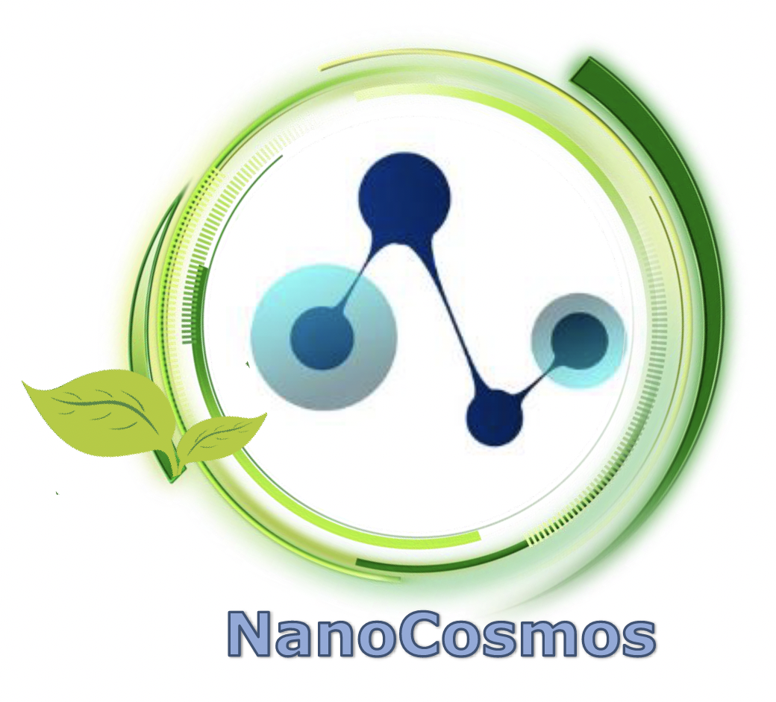



Current international Food Chemistry projects
Shielding food safety and security by enabling the foresight of fungal spoilage and mycotoxins threats in the Mediterranean region under climate change conditions HORIZON-WIDERA-2021-ACCESS-03-01
SUstainable nanoPaRticles Enabled antiMicrobial surfacE coatings HORIZON-CL4-2021-RESILIENCE-01
Nanoencapsulation of bioactive compounds from plant by products to produce sensitive skin cosmetics
MARIE SKŁODOWSKA-CURIE ACTIONS, Staff Exchanges (SE) Call: HORIZON-MSCA-SE-2021
Excellence hub in green technologies: Introducing innovation ecosystems in the Mediterranean food value chain
HORIZON-WIDERA-2022-ACCESS-04
The European Food Risk Assessment (EU-FORA) Fellowship Programme (2022-2023)
HORIZON MSCA 2021 SE 01

Slide 8
Food Chemistry projects funded by domestic sources
“Development and Installation of Innovative Technologies in rice cultivation to improve the competitiveness of Agricultural Farms” – ΥΔΡΟΤΟΜΩ
“Methodology development for the quality control-adulteration of olive products, using modern analytical and chemometric techniques” – HOLEA
“Encapsulation of bioactive compounds from aromatic and medicinal plants in nanoparticles for use in the production of: a) Biofunctional foods & Nutritional Supplements, b) Livestock protection products, c) Plant protection products” – ENBIOS
“Capturing the atomic and metabolomic profile of Greek wine products and spirits of Northern Greece, Sections 3 and 6” – BACHUS
“Chemical Analyses of wine products and spirits from Greek regions known for the production of wine spirits (tsipouro) and products (vinegar)” – BACHUS
“Development and production of innovative bio-functional pastry products with high nutritional value, based on the traditional sourdough, and enriched with plant antioxidants from agro-food by-products of the Attica Region” – FUNBAKES
“Prominence of the plant biodiversity of the Attica Region, through the utilization of its beekeeping plants, for the production of innovative and culinary honey products, with the use of modern encapsulation technologies”
Provision of services and analysis of raw materials and finished soft drink product from Sea Buckthorn leaves.
Provision of services and analyses of infusion, value-added water with sea buckthorn leaves.
HORIZON MSCA 2021 SE 01

Slide 9
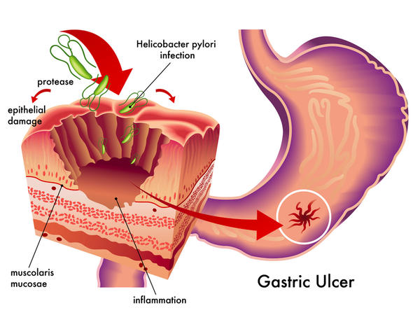


Laboratory of Organic Chemistry
Rational design and synthesis of Urease inhibitors
CHEMISTRY AND HEALTH
DISCOVERY OF NOVEL COMPOUNDS WITH PHARMACOLOGICAL ACTION

Slide 10



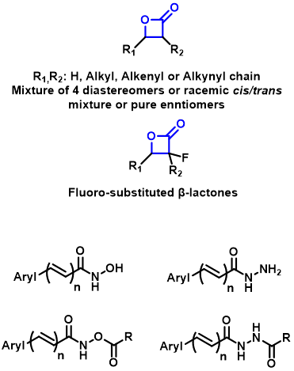
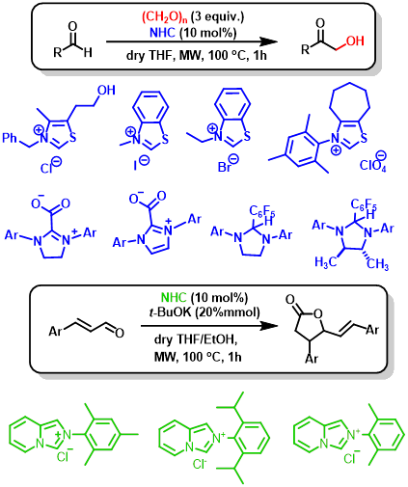
Tetrahedron 2016, 72, 7628; Tetrahedron 2017, 73, 7295; Tetrahedron Lett. 2020, 61, 151419.

Slide 11
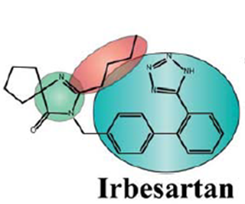

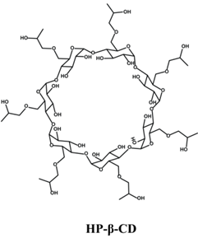
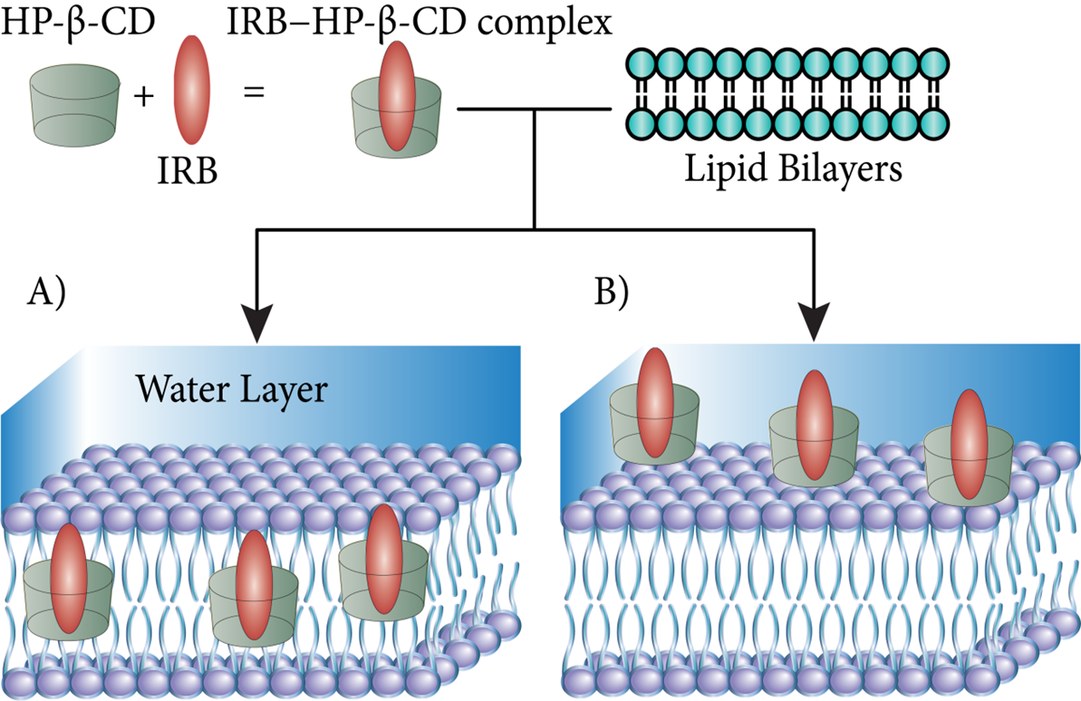

Slide 12
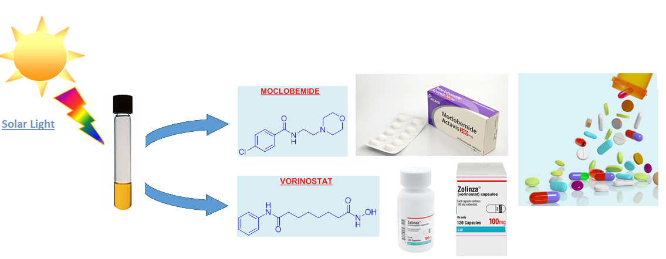
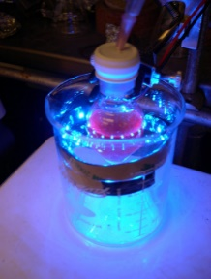

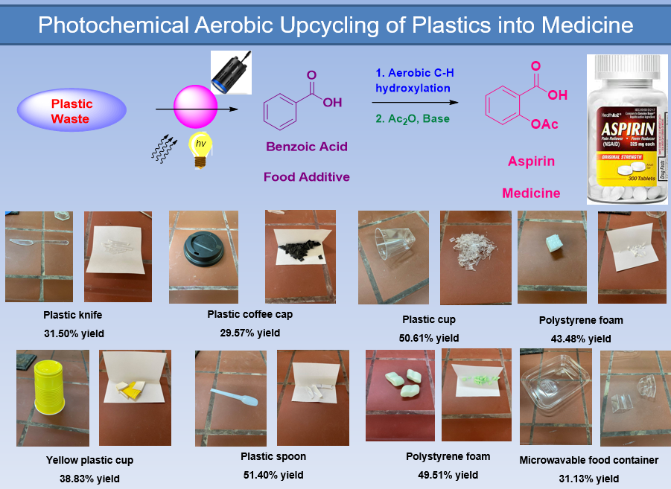
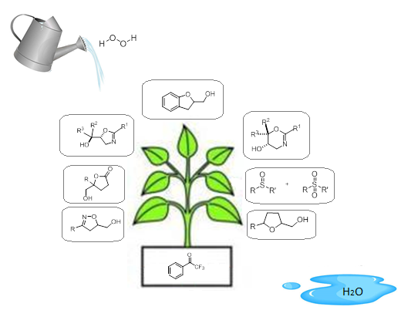




Photochemistry – Upcycling of Plastic waste
Assoc. Prof. Christoforos Kokotos
Trends Chem., 2023, 5, 116
ChemSusChem, 2023, 16, e202201998
Green Chem., 2022, 24, 6224
Green Chem, 2022, 24, 4108
ChemSusChem, 2022, 15, e202102441
Green Chem., 2021, 23, 546
ChemSusChem, 2020, 13, 5934
Angew. Chem. Int. Ed., 2020, 59, 1735
Green Chem., 2020, 22, 3539
Green Chem., 2020, 22, 471
Green Chem., 2019, 21, 669
Organocatalytic Oxidations – Medicinal Chemistry –Green Solvents
Green Chem., 2022, 24, 6435
Chem. Sci., 2021, 12, 10191
J. Med. Chem., 2021, 64, 5654
Adv. Synth. Catal., 2019, 361, 1792
Green Chem., 2017, 1291
Adv. Synth. Catal., 2017, 359, 1577
Org. Lett., 2017, 19, 106
Green Chem., 2017, 19, 670
Chem. Eur. J., 2015, 21, 5238
J. Org. Chem., 2014, 79, 4270
Chem. Eur. J., 2014, 20, 559
ACS Catalysis, 2013, 3, 2239
2014 Academic Young Investigators

Slide 13

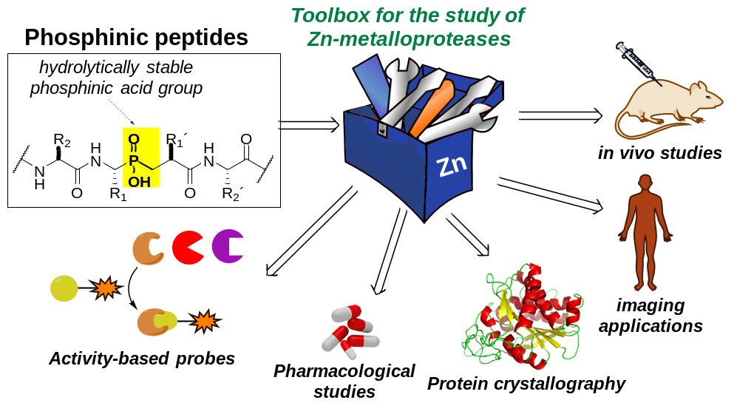
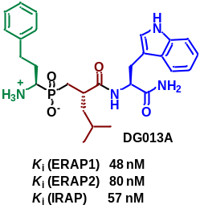
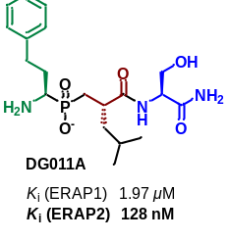
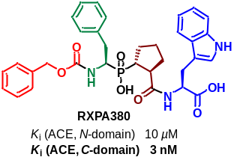



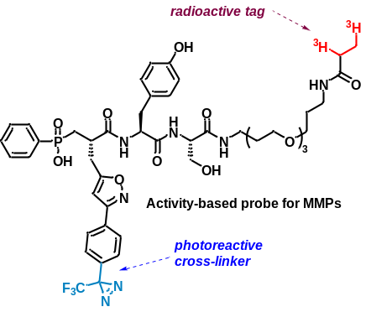
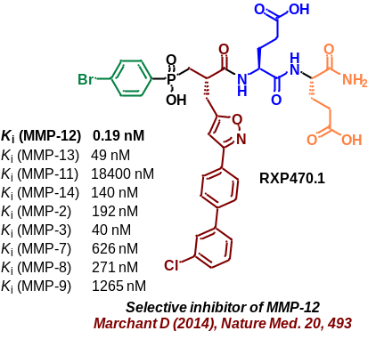

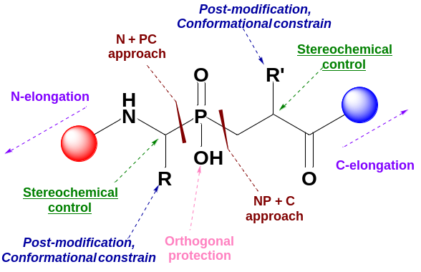
DIMITRIS GEORGIADIS’ RESEARCH GROUP
Examples of inhibitors and probes developed by Georgiadis’ Group
Design and synthesis of potent and selective inhibitors of Zn-metalloproteases involved in severe pathologies (hypertension, tumor metastasis, arthritis, autoimmune diseases, etc).
Development of molecular tools based on Zn-metalloprotease inhibitors for applications in various fields of biochemistry/biology/medicine
Development of synthetic methodologies towards organophosphorus bioactive compounds.
Main synthetic targets: (a) Late stage diversification or functionalization, (b) Introduction of conformational constraints, (c) Novel P-C bond-forming reactions, (d) Optimization of synthetic methodologies in terms of stereoselectivity and efficiency. (e) Combinatorial chemistry
Kokkala, P. (2022) Molecules 27, 1242
Kaminska, M. (2021) Angew Chem 133, 18420
Kokkala, P. (2021) Org. Lett. 23, 1726
Covaleda, G (2019) J. Med. Chem. 62, 1917
Voreakos, K. (2019) Org. Lett. 21, 4397
Bordenave, T. (2016) Bioconjugate
Chem. 27, 2407
Kalyva, M. (2015) Chem. Eur. J. 21, 3278
Georgiadis, D. (2015) Top. Curr. Chem. 1-38
Rogakos, V (2009) Org. Lett. 11, 4696
Nasopoulou, M. (2007) J. Org. Chem. 72, 7222
Georgiadis D. (2022), ACS Pharmacol Transl Sci 5, 1228
Georgiadis D. (2020), Front. Pharmacol. 11, 585838
Jullien N. (2010) J. Med. Chem. 53, 208-220
Georgiadis D. (2008) Bioorg. Med. Chem. 8781

Slide 14

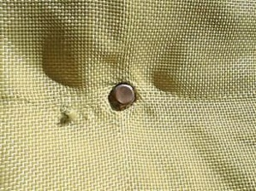

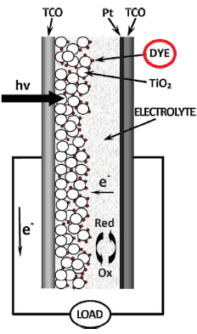
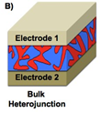
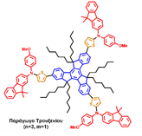
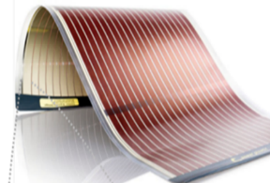
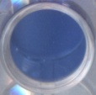
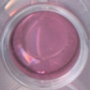
Vougioukalakis Research Group: Selected Projects
http://users.uoa.gr/~vougiouk/
vougiouk@chem.uoa.gr
PROTECT project ► Improve the properties and durability of Kevlar (anti-ballistic), Nomex (heat-resistant/insulating), and cellulose fibbers and materials (UV-resistance, anti-bacterial, flame retardant, water-repellent) via surface modifications.
► PROTECT was ranked 2nd out of 206 projects/consortia in the field of “Materials-Constructions” that competed in the specific call (Research-Create-Innovate) amongst all Greek Universities, Research Institutions, SMEs, and Industries.
Consortium ► Vougioukalakis’ group, University of Athens (Chemical Synthesis)
Tagmatarchis’ group, National Hellenic Research Foundation (Materials Development)
Costas Siamidis S.A. (Materials Evaluation – Bulletproof Vest Prototypes Development)
Greek Ministry of Defense – 700 Greek Army Factory (Materials Evaluation)
Total Project Funding: 871,002.32 €.
Materials for Dye-Sensitized & Perovskite Solar Cells
Materials for Chemosensors, Biosensors & Diagnostics
Materials for Organic Electronics
Tzartos
Other Selected Projects:
Neurodiagnostics
Advent
Technologies S.A.
NCSR
Demokritos
J. Am. Chem. Soc. 2004, 126, 15956
Knight
NCSR
Advent
Scientific
J. Phys. Chem. C 2014, 118, 2361
J. Phys. Chem. C 2014, 118, 16760
Demokritos
Technologies S.A.
Ltd
ChemistrySelect 2016, 6, 1232
ChemSusChem 2015, 8, 588
NHRF - ITPC
Eur. Pol. J. 2016, 83, 148
ChemPlusChem 2016, 81, 913
Synlett 2017, 28, 929
Nature Commun. 2021, 12, 4868
Sensors 2020, 20, 5172
Dyes Pigments 2019, 165, 308
J. Mater. Chem. C 2022, 10, 12751
Notes:
On a different front, we are also implementing one other multidisciplinary project, which aims at developing multifunctional personal shielding media, by chemically improving the properties of Kevlar and Nomex, which are anti-ballistic and flame-resistant materials, respectively. Again, we are the chemists of a highly multidisciplinary consortium.

Slide 15
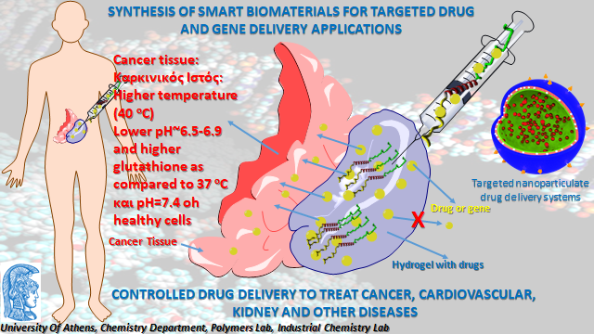
LABORATORY OF POLYMERS

Slide 16
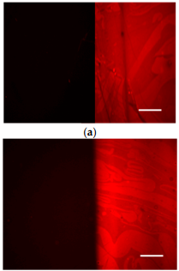
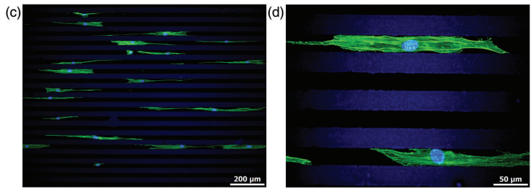
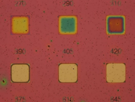
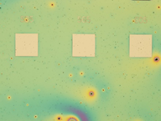
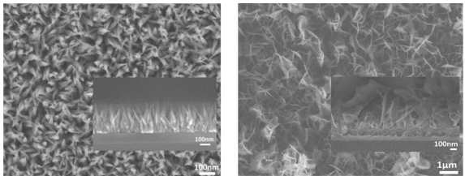
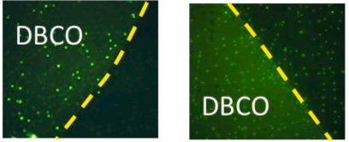
Margarita Chatzichristidi’s Group
Research & Scientific Interests
Micromachining
Fabrication of novel devices using non- conventional lithography
Fabrication of microsystems using conventional lithographic patterning methods
Design and characterization of materials suitable for organic electronics
Lithographic evaluation of new materials
Surface modification for bio-applications
Lithographic materials for specific attachment of biomolecules and cells
Polymer nanocomposite with metal oxides
Chemical methods for 3D nano-architectures of metal oxides
Surface modification for bio-applications
Lithographic materials for specific attachment of biomolecules and cells
Metal oxides and Polymer nanocomposites with MO
Fluorescence microscope from silicon wafers coated with (a) PFMA homopolymer and PFMA:VBGE 1:1 copolymer after incubation with biotinylated BSA and reaction with AlexaFluor546 labelled streptavidin (the left is the unexposed area of the film and on the right is the exposed)
A. Nika et al. , Polymers 15 (2023) , 493.
Fluorescence microscopy images of smooth muscle cells adherent after 1-day culture on photopatterned: PEG-b-PTHPMA43-57 diblock copolymer films with a stripe pattern of 25-μm.
D. Kourti et al. Macromol. Biosci. 23 (2023) , 2200301
Contrast curve patterns of CuO/PMMA nano-composites as e-beam resist materials.
G. Geka et al., Nanomaterials 11(3) (2021), 76
Fluorescence images obtained from surfaces reacted with 5-FAM-azide after modification with: EPRmed/ rabbit IgG reacted with sulfo-NHS-DBCO for 2 h, and 24 h
Vrettou et al. Surfaces and Interfaces 36 (2023) 102500
SEM images of the hydrothermally-grown (a) flame-like CuO nanostructures and nanosheets/nanopetal-like NiO
V. Constantoudis et al., Micro and Nano Engineering 16 (2022) 100148

Slide 17
Inorganic Chemistry Laboratory
The research of its members extends from basic chemistry to applications in Catalysis, Energy, Biological, and Environmental Chemistry.
Computational Chemistry is also under staff’s interest for elucidating the mechanisms of the reactions and the active sites of catalysts.
Synthesis and characterization of molecules and nanomaterials are the focus of Inorganic Lab's research.

Slide 18
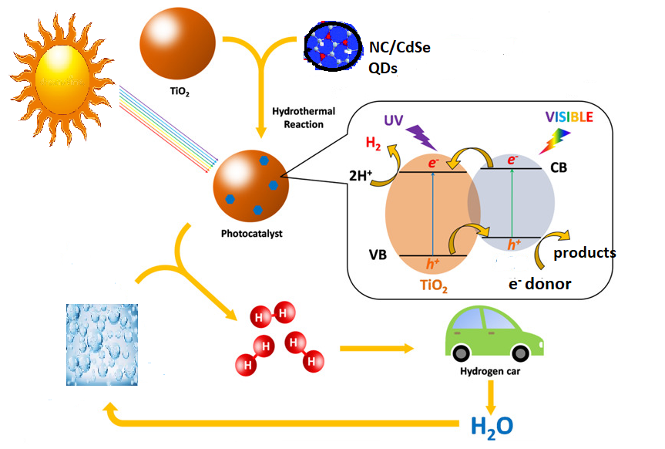
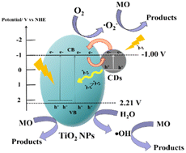
-Biomimetic evolution of hydrogen from water by electrocatalysis and photocatalysis.
-Design of catalysts with non-innocent ligands and low-cost, highly abundant, and environmentally friendly metal ions.
-Synthesis of nanomaterials (semiconductors, quantum dots, npsTiO₂ etc) acting as photosensitizers/photocatalysts
-DFT calculations
Renewable Chemical Sustainable Energy
Photocatalysis and Electrocatalysis Lab./ C. Mitsopoulou
Photocatalytic nanoparticles based on quantum dots and TiO₂ for photodynamic therapies / applications

Slide 19
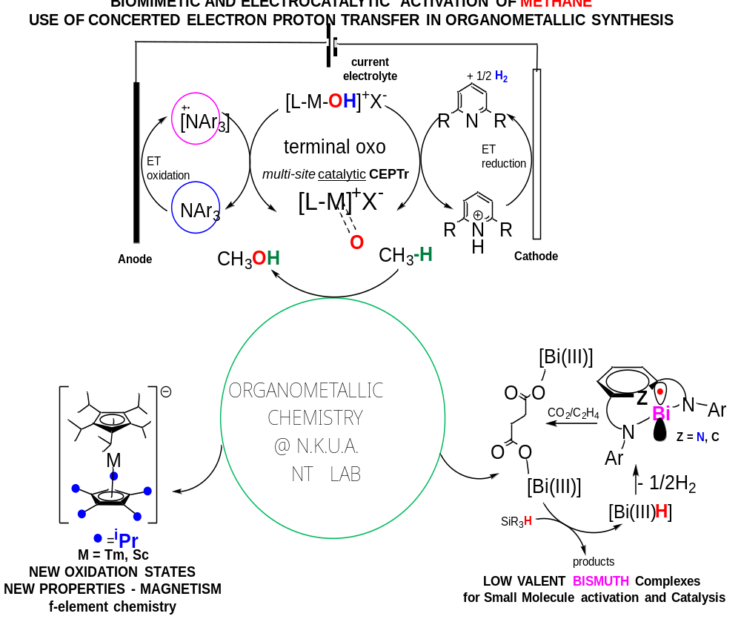
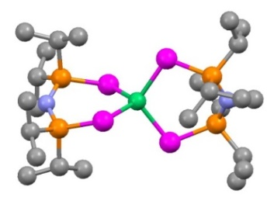
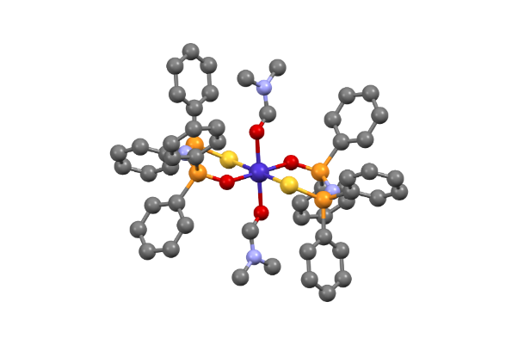
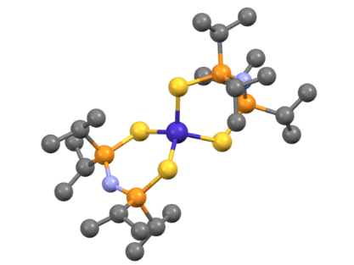
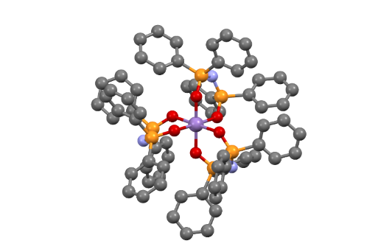
Metal complexes exhibiting characteristic magnetic properties
Tetrahedral, S = 1, [Ni{^{i}Pr₂P(Se)NP(Se)^{i}Pr₂}₂], Large zero-field splitting: D = 45 cm⁻¹
S.-D. Jiang, D. Maganas, N. Levesanos, E. Ferentinos, S. Haas,
K. Thirunavukkuarasu, J. Krzystek, M. Dressel, L. Bogani, F. Neese, P. Kyritsis,
J. Am. Chem. Soc., 2015, 137, 12923-12928.
3d-metal Single Ion Magnets
Tetrahedral Octahedral Octahedral
S = 3/2, S = 3/2 S = 2,
[Co{^{i}Pr₂P(S)NP(S)^{i}Pr₂}₂, trans-[Co{Ph₂P(O)NP(S)Ph₂}₂(dmf)₂] [Mn{Ph₂P(O)NP(O)Ph₂}₃]
S. Sottini, G. Poneti, S. Ciattini, N. Levesanos,
E. Ferentinos, J. Krzystek, L. Sorace, P. Kyritsis,
Inorg. Chem., 2016, 55, 9537-9548.
E. Ferentinos, et al,
Inorg. Chem. Front., 2019, 6, 1405-1414.
Y. Sanakis,. et al, Inorg. Chem., 2020, 59, 13281-13294.
N. Tsoureas
Panayotis Kyritsis

Slide 20
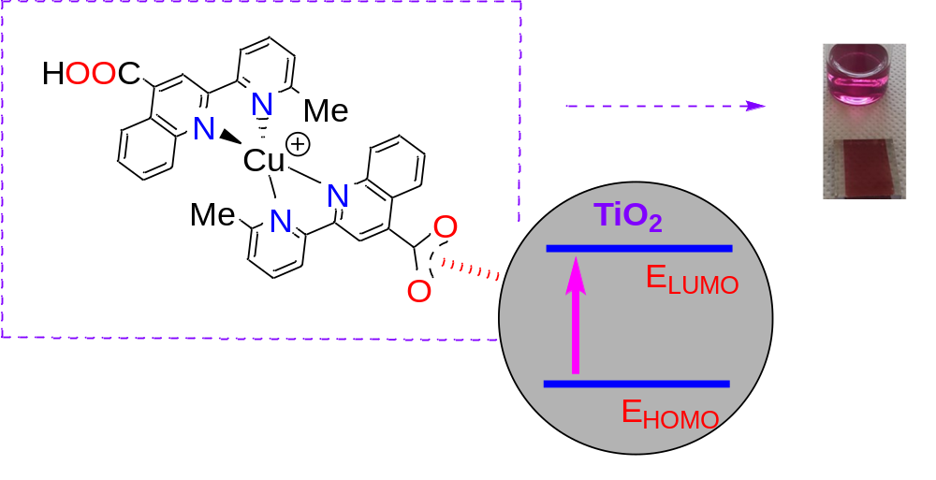
1
Α nanocrystalline TiO₂
Dye Sensitized Solar Cell device consisting of a low-cost and easily prepared copper(I) molecular sensitizer, fabricated with commercially available materials, reaches a conversion efficiency of η = 1.20%.
Dalton Trans. 51 (2022) 15049-15066, themed
collection: Spotlight Collection focused on Inorganic Chemistry in Greece, “hot article”
“Inflammatory mediator inhibitors” based on transition metal complexes constitute a recently coined term in the field of metal-based compounds with antiplatelet activities. Our strategy focuses on the Platelet-Activating Factor (PAF) as the target molecule, that is the most potent lipid mediator of inflammation. The antiplatelet potency of any substance is exerted by inhibiting the PAF-induced aggregation in washed rabbit platelets (WRPs), which is the most internationally accepted methodology.
2
Guest Editor, Special issue of Molecules entitled: “Αntiplatelet and anti-inflammatory agents: Synthesis, Structures and Biological Evaluation”, 2023.

Slide 21
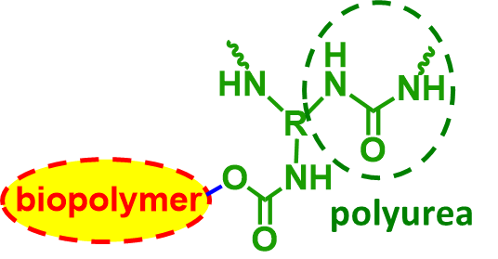


X-biopolymer aerogels
Polyurea-crosslinked biopolymer (X-biopolymer) aerogels
a new class of lightweight nanostructured materials
mechanically strong
stable in all aqueous environments, including seawater
biocompatible
precursors for metal- and nitrogen-doped nanoporous
carbons suitable for CO₂ capture and activation
P. Paraskevopoulou et al, EP3848409A1, 2021
G.S. Papaefstathiou

Slide 22





Metallic and polymeric nanoparticles for theranostic applications
Photocatalytic nanoparticles based on TiO₂
In vitro evaluation of NPs
Fluorescent imaging for
U87MG with Ag NPs
MTT assay toxicity studyin HaCaT cell line
Apoptosis through Flow Cytometry in U87MG with iron mNPs

Slide 23



Analysis of Circulating Tumor Cells Lab (ACTC Lab) (http://www.actc-lab.chem.uoa.gr/
Liquid biopsy
Detection and molecular characterization of circulating tumor cells
Detection of circulating tumor DNA, MiRNAs, exosomes
The ACTC Lab has been accredited with an ISO 15189 certificate to perform liquid biopsy analysis.
Patents
Cancer Blood Scan Project
Awards
Publications
Preoperative Mutational Analysis of Circulating Tumor Cells (CTCs) and Plasma-cfDNA Provides Complementary Information for Early Prediction of Relapse: A Pilot Study in Early-Stage Non-Small Cell Lung Cancer, Cancers 2023, 15(6), 1877; https://doi.org/10.3390/cancers15061877
Development and Analytical Validation of a 6-Plex Reverse Transcription Droplet Digital PCR Assay for the Absolute Quantification of Prostate Cancer Biomarkers in Circulating Tumor Cells of Patients with Metastatic Castration-Resistant Prostate Cancer, Clin Chem. 2022 Oct 6;68(10):1323-1335. doi: 10.1093/clinchem/hvac12
Development and Analytical Validation of a One-Step Five-Plex RT-ddPCR Assay for the Quantification of SARS-CoV-2 Transcripts in Clinical Samples, , Anal Chem. 2022 Sep 13;94(36):12314-12322. doi: 10.1021/acs.analchem.2c00868. Epub 2022 Aug 12.

Slide 24




Sensors Lab (http://scholar.uoa.gr/christok)
Fabrication of smart sensors and biosensors through microengineering, 3D-printing and other printing technologies.
Wearable sensors
Paper-based devices
Projects
3D-printed Devices
Smart sensors
Paper-based devices
Publications
3D Printed Bioelectronic Microwells", Advanced Functional Materials, 2021, DOI: https://doi.org/10.1002/adfm.202102459
"Smartphone-Addressable 3D-Printed Electrochemical Ring for Nonenzymatic Self-Monitoring of Glucose in Human Sweat" Analytical Chemistry, 2021, 93, 7, 3331–3336
“Paper-based microfluidic device with integrated sputtered electrodes for stripping voltammetric determination of DNA via quantum dot labeling” Analytical Chemistry, 2018, 90, 1092-109

Slide 25




Trace Analysis and Mass Spectrometry (TrAMS) Group (http://trams.chem.uoa.gr/)
Foodomics
Mass Spectrometry
Chemometrics
Emerging Contaminants
Wastewater-based Epidemiology
The Laboratory is accredited under EN ISO/IEC 17025 by the Hellenic Accreditation System S.A.
Food adulteration
MALDI-TOF-MS
Powerful tools have been developed for the detection of food adulteration combining metabolomic profiling, metabolomic fingerprinting and chemometrics
Projects
GC-APCI-QTOFMS
Publications
First Novel Workflow for Semiquantification of Emerging Contaminants in Environmental Samples Analyzed by Gas Chromatography–Atmospheric Pressure Chemical Ionization–Quadrupole Time of Flight–Mass Spectrometry”, Analytical Chemistry, 2022, 94, 27, 9766–9774
“ SARS-CoV-2 wastewater surveillance data can predict hospitalizations and ICU admissions” Science of the Total Environment, 2022, 804, 150151 (doi: 10.1016/j.scitotenv.2021.150151)
“Proteo-metabolomic journey across olive drupe development and maturation”, Food Chemistry, 2021, 363(7):130339 (doi:10.1016/j.foodchem.2021.130339)

Slide 26




















ENVIRONMENTAL CHEMISTRY LABORATORY
MAIN RESEARCH FIELDS
Chemistry of aquatic systems (microenvironments) including marine, surface and ground waters and sediments: circulation, chemical behavior and distribution of metals, nutrients and organic pollutants
Speciation of several elements in natural systems and study of species responsible for their biological activities and impact
Chemistry of the atmospheric environment, determination of several pollutants in aerosols
Ecotoxicological studies in aquatic ecosystems and bioaccumulation studies in biota and foodstuffs
Study of liquid and solid wastes and their impact on the environment, wastes management
Environmental management of aquatic and marine systems
Environmental impact and establishment of environmental standards for industrial sectors
Study / accreditation of environmental analytical techniques

Slide 27
ENVIRONMENTAL CHEMISTRY LABORATORY
MAIN RESEARCH FIELDS
Atmospheric pollution (sources, emissions, monitoring of primary and secondary pollutants in air and particulate phase)
Development of analytical methods for the determination of atmospheric pollutants
Quality assurance of atmospheric pollution measurements
Impact of atmospheric pollution on human health (outdoor environment and indoor air)
Substrate…
Ambient air
Indoor air
Vehicle emissions
Industrial emissions
Shipping emissions
Water
Human serum
Human blood
Pollutants……
Volatile Organic Compounds (VOCs)
Metals (As, Cd, Cr, Cu, Hg, Ni, Pb, Zn)
CH₄, CO, CO₂, HFCs, N₂O, NH₃, PFCs, SF₆, SΟ_{x}, NΟ_{x}
Carbonyl compounds
Organic and elemental carbon in suspended particles
Polycyclic Aromatic Hydrocarbons (PAHs)
Polychlorinated Biphenyls (PCBs)
Trihalomethanes
Chloroacetic acids
Ions
Atmospheric particles (PM₁₀, PM_{2.5})
Metabolites

Slide 28







ENVIRONMENTAL CHEMISTRY LABORATORY
(Inductively Coupled Plasma - Mass Spectrometer, Thermo ICAP-Qc)
GC-ToFMS
(GCT Premier, Waters)
Electrochemical Analyser (Ecochemie)
Clean room
Flame Atomic Absorption Spectrometer
(Varian SpectrAA 200)
GC-MS
(6890/5973, Agilent)
Graphite Furnace Atomic Absorption Spectrometer (Varian SpectrAA 640Ζ)

Slide 29


Surface Science
Electrical & spectroscopic study of spontaneously charged films
STM studies of molecular constructs
Ru tetraphenyl porphyrin on Ag(111)

Slide 30


Computational studies
High precision calculations on (unusual) small molecules
Structure, energetics and reaction paths in complex systems
Molecular dynamics simulations with charged species
N₂X⁺, X = F, Cl, Br, I
Be₂⁺, Be₂, Be₂⁻

Slide 31

Nuclear reactions: Experiments and modelling
N. Vonta, G. A. Souliotis, M. Veselsky, and A. Bonasera. “Microscopic dynamical description of proton-induced fission with the constrained molecular dynamics model”, Phys. Rev. C 92, 024616 (2015).
N. Vonta, G.A. Souliotis, et al; Phys. Rev. C 94, 064611 (2016).

Slide 32










Journal Covers

Slide 33












CHEMISTRY IS OUR LIFE
AND OUR FUTURE
Acknowledgements
T. Mavromoustakos
C.A. Mitsopoulou
A. Economou
H. Proestos
A. Koutselos
E. Stratikos
E. Iatrou
E. Bakeas

